Slide 1

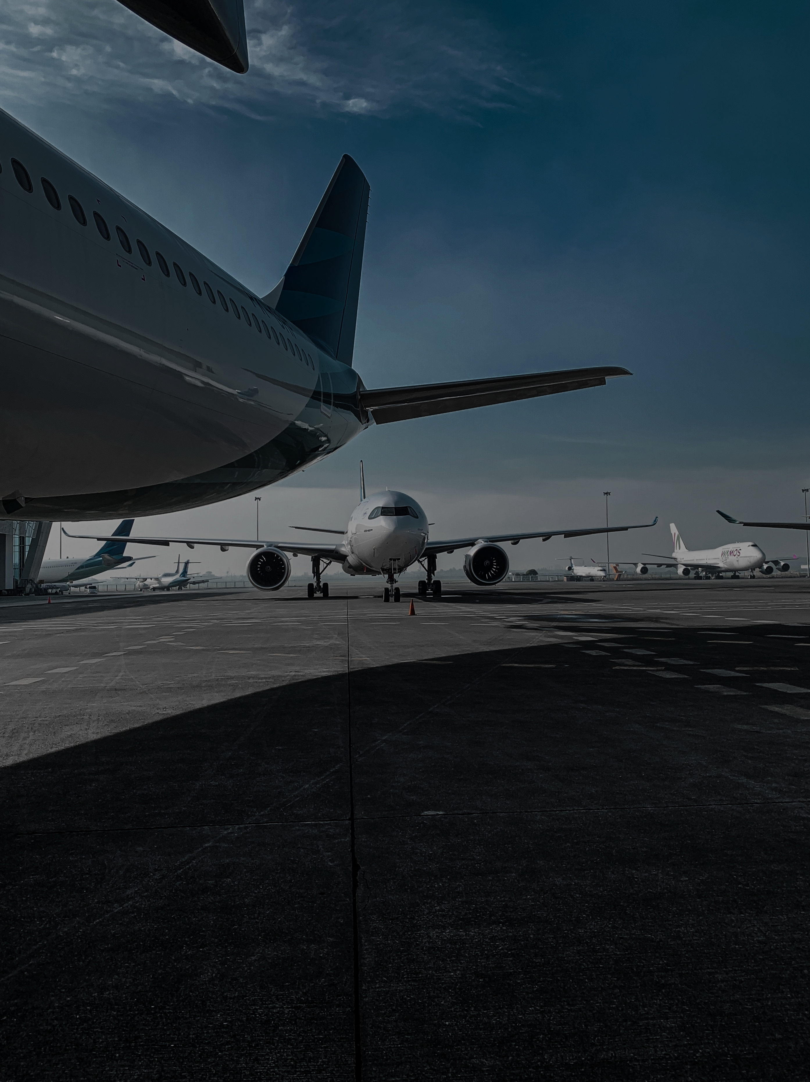



Notes:
Good evening everyone, here we will be updating our progress in the eleventh week

Slide 2



Facts
In 2019, Indonesia produce 6.1-million-ton of fishes
Consume rate in Indonesia haven't reach 60 kg per capita in 2020
Marine product has complicated supply chain and lack infrastructure
Consumption rate exceed their production rate in some region
Marine Products do not have a long time to be stored
With the high supply and demand for marine product, the need for fast mode of transportation increase
Notes:
Before we jump into our company, we would like to give out some facts currently happening. In 2019 Indonesia produce almost 6.1 millions ton of fishes or the third largest producent in the world, but sadly the consume rate haven't even reach 60 kg per capita in 2020. This of course due to many aspects one of it is that marine product has complicated supply chain and lack of infrastructure such as means of transportations. And even in some region their consume rate is higher than the production rate in that particular area also if they want to get it from another region Marine Products do not have long time to be stored. With all this known facts Indonesia is urgently need fast mode of transportation that focus delivering marine products

Slide 3
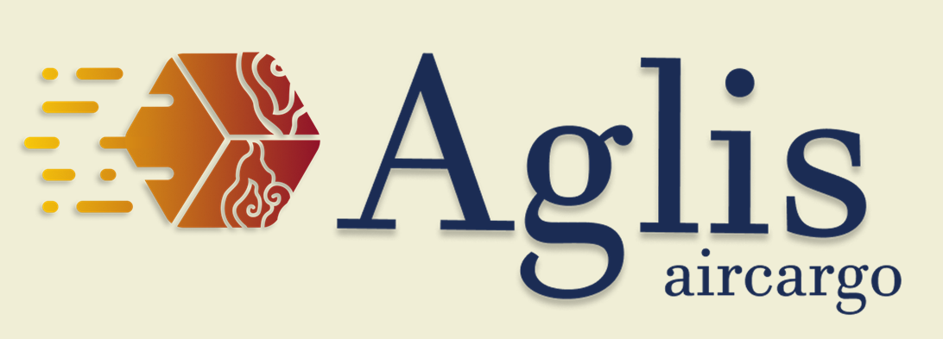
Introducing
Aglis Aircargo is a middle mile service Cargo Airline which focuses on delivering marine products and general goods
Notes:
And here where we came into the play. Introducing you, Aglis where we fly the sea you deserve. Aglis Aircargo is a middle mile service Cargo Airlines which focuses on delivering marine products and general goods

Slide 4


Vision
"Spread sustainable marine products for everyone as a leading air cargo airline focusing in transporting marine goods”
Mission
“Maximize Indonesia’s marine potential and fulfill its local’s needs through fast air cargo delivery”
Notes:
Aglis has its vision statement as we believe to spread sustainable marine products for everyone as leading air cargo airlines focusing in transporting marine goods. And with its mission to maximize Indonesia marine potential and fulfill its local’s needs through fast air cargo delivery

Slide 5
Our Values
Customers Focus
Punctual
Affordable
Reliable
Large Volume
Responsible
Notes:
With all being said, Aglis has 6 values we hold. We believe in giving our customers the best service we can give and prioritize our customers needs for transporting goods. Punctual, Affordable, Reliable, and Responsible is keys in our promise of giving the best services. We also offer large volume compare to the competitor belly cargo

Slide 6
Organization Structure
Board Of Commissioner
Chief Executive Officer
Executive Secretary
Chief Operating Office
Chief Finance Office
Chief Marketing Officer
Chief Technology Officer
Chief Human Resources Officer
VP Flight Operations
VP Ground Operations
VP Accounting
VP Budgeting
VP Investment
VP Risk managements
VP Route and Network Planning
VP Marketing
VP Revenue Management
VP Airworthiness
VP Fleet Management
VP Maintenance
VP IT
VP Personnel Management
VP Legal Affairs
VP Quality Assurance
Notes:
Our Organization structure consist of Board Commissioner, Executive Secretary, 6 Chief Officer, 16 Vice president. CEO works as the face of the company and highest decision maker. COO deals with day to day flight to flight affairs, CFO in charge for financial, CMO works with potential route and revenue management also marketing through commercial. CTO deals with Aircraft and technology that supports Aglis. CHRO in charge for personnel, legal, and Quality affairs

Slide 7

Industry Overview
Notes:
Then we will talk about how the Industry of Air cargo is happening

Slide 8
5 Porter's Forces
Relatively Moderate
With loosen up law through Omnibus Bill to enter Aircargo is easier
Relatively High
Many option for Buyer to send their product from cargo airline and sea transportation
Relatively High
With 6 major airlines play into the cargo industry
Bargaining Power of Suppliers
Threat of Substitute Products
Relatively High
There's duopoly of aircraft manufacture and fuel price is hard to control
Relatively Low
Because the targeted customers of Aglis is someone who wants to ship their goods fast
Rivalry among existing competitors
Threat of New Entrants
Bargaining Power of Buyers
Notes:
According to Porter, there are 5 forces that driven the industry. Those forces are threat of new entrants, Bargaining power of suppliers, Bargaining power of Buyers, Threat of substitute products, and Rivalry among existing competitors. In air cargo industry this 5 forces also applied, With the loosen up law through omnibus law in 2020 to enter air cargo become more easier hence the threat of new entrants relatively moderate. For bargaining power of suppliers because the suppliers of aircraft is duopoly and the fuel price is very hard to control, it is consider high. With many option in the market to send goods it is easier for buyer to change option, hence the bargaining power of buyers consider high. The substitute for sending large amount of marine product in fast manner is unlikely hence the threat of substitute product is low. But the rivalry among existing competitor is quite high

Slide 9
Pestle
P
E
S
T
L
E
Political : Aglis is indirectly supported by the government directive to increase the local marine product consumption, leading to higher demand for marine products with "GEMARIKAN"
Economics : The COVID-19 Pandemic slowed down the worldwide economy, hopefully with the presence of our company we can build back the economics of Indonesia.
Social : The target market of Aglis air cargo is directed to a place where the production of maritime product is overflowing, and we hope to transport the product to the place where the demand of maritime product is high.
Technology : We want to implement technology to provide simplicity and security for our customer with live tracking of the cargo.
Legal : The many regulations of air travel will become a challenge for Aglis air cargo to overcome.
Environment : Sulawesi, where Aglis plans to base on has a very strong maritime industry, whereas on the other area such as Java is quite weak, thus creating an opportunity for us as a cargo company.

Slide 10

SWOT
Affordable fare
Focusing on marine product
A newcomer in the industry, with no prior experience or reviews
S
W
The high demand and supply of marine product in Indonesia
The government “GEMARIKAN” movement
Businesses and marine product carrier by sea transportation serving the market
O
T
Notes:
After understanding the industry we can see how Aglis position it self through SWOT analysis. Aglis has strength of affordable price and focusing on marine product. And support with opportunity of high demand and supply of marine product in Indonesia and government's movement of GEMARIKAN. How ever as a newcomer this become Aglis' weakness and the threat of existing airfreight and sea transportation odes serving the market is there

Slide 11
TOWS
 | Strength | Weakness
Opportunities | With the high supply and demand hence, there are many customers and with the affordable price that Aglis offers means Aglis will be one of the consideration for delivering the marine product Because Aglis focus on sending Marine Product, the potential for government collaborating with Aglis through GEMARIKAN movement is high | Even though Aglis is new in the industry, with high demand and supply in marine product also indirectly due to GEMARIKAN movement. Aglis potentially will still ably grab the market and grow exponentially
Threat | With affordable and more focus target, Aglis will be able to compete with the competitor. | As newcomer in high competing environment, Aglis will be able to tackle this problem by focusing on niche market and high potential market
Notes:
Now the SWOT analysis then process into TOWS analysis.....

Slide 12
Market Analysis
Notes:
So for cost calculating:

Slide 13
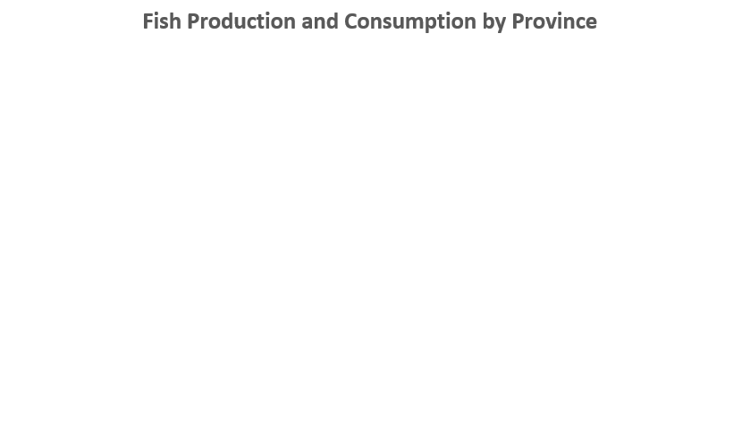
Marine Product Market
Provinces with most fish production and consumption
High Production
Provinces | Daily net fish Production (Ton)
SUMATERA SELATAN | 980.88
SULAWESI UTARA | 745.77
SUMATERA BARAT | 478.03
MALUKU | 434.55
KALIMANTAN TENGAH | 315.87
MALUKU UTARA | 277.63
NUSA TENGGARA BARAT | 272.67
SULAWESI TENGGARA | 205.95
High Consumption
Provinces | Daily net fish consumption (Ton)
PAPUA | 93.317
KALIMANTAN BARAT | 96.329
JAWA BARAT | 159.011
SUMATERA UTARA | 231.546
RIAU | 231.607
BANTEN | 624.773
JAWA TENGAH | 677.113
JAWA TIMUR | 939.872
Source: KKP.go.id
Notes:
Based on KKP database, here are the mapping of fish production and consumption by province. The one highlight with green means that province has a large production of fish. On the other hand, the red indicates province with high consumption of fish. In general we can say that java insland has a large marine product demand. The table on the right side indicates the net fish production and consumption. Here we can see sumatera selatan and Sulawesi utara as the top 2 net fish production. On the bottom table, we can see that jawa timur, jawa tengah, and banten have the largest fish demand. With this data, Aglis air wants to deliver marine product from province with high production to province with high consumption

Slide 14
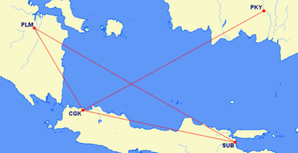
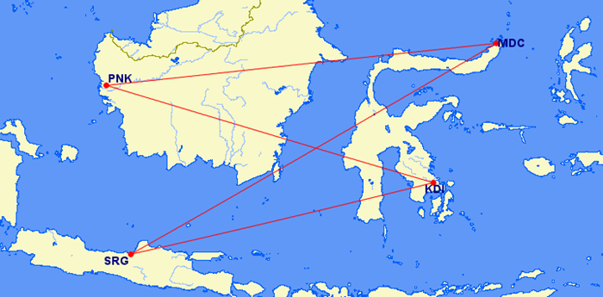
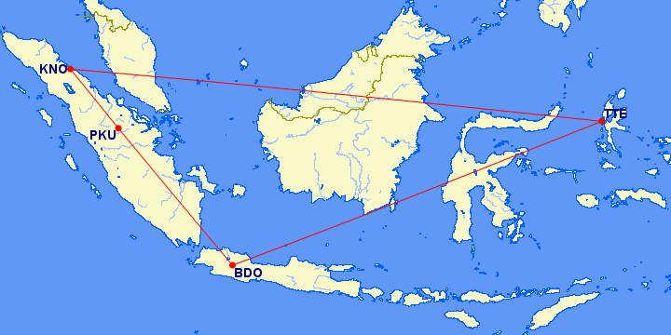
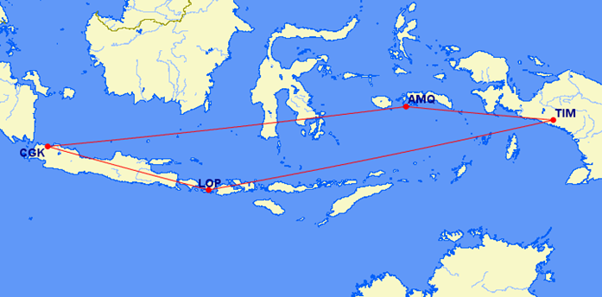
Route Rotation
Rotation 1 (PLM-SUB, SUB-CGK, CGK-PKY, PKY-CGK, CGK-PLM)
Rotation 2 (MDC-SRG,SRG-KDI,KDI-PNK,PNK-MDC)
Total BH = 13.58
Rotation 3 (TTE-KNO,KNO-PKU,PKU-BDO,BDO-TTE)
Rotation 4 (LOP-TIM,TIM-AMQ,AMQ-CGK,CGK-LOP)

Slide 15
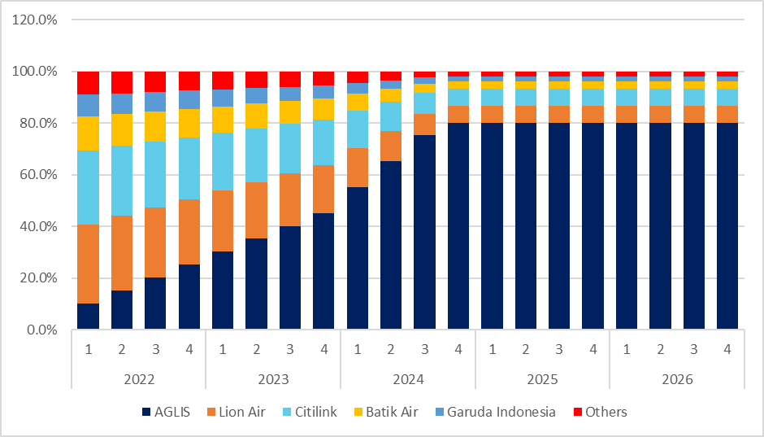
Market Share & Capacity Share
On average, Aglis capacity share is 10% on the first year.
On 2024, Aglis capacity share expand to approximately 80%

Slide 16
Tonnage Carried by Aglis Air
Daily Cargo Carried (Tons)
 | 2022 |  |  |  | 2023 |  |  |  | 2024 |  |  |  | 2025 |  |  |  | 2026
 | 1 | 2 | 3 | 4 | 1 | 2 | 3 | 4 | 1 | 2 | 3 | 4 | 1 | 2 | 3 | 4 | 1 | 2 | 3 | 4
PLM-SUB | 2.1 | 4.2 | 6.3 | 8.4 | 11.5 | 13.8 | 16.1 | 18.4 | 20.3 | 20.3 | 20.3 | 20.3 | 22.3 | 22.3 | 22.3 | 22.3 | 24.5 | 24.5 | 24.5 | 24.5
SUB-CGK | 2.4 | 4.7 | 7.1 | 9.5 | 13.0 | 15.6 | 18.2 | 20.8 | 22.9 | 22.9 | 22.9 | 22.9 | 25.2 | 25.2 | 25.2 | 25.2 | 27.0 | 27.0 | 27.0 | 27.0
CGK-PKY | 1.5 | 3.0 | 4.4 | 5.9 | 8.1 | 9.8 | 11.4 | 13.0 | 14.3 | 14.3 | 14.3 | 14.3 | 15.8 | 15.8 | 15.8 | 15.8 | 17.3 | 17.3 | 17.3 | 17.3
PKY-CGK | 1.8 | 5.4 | 9.0 | 12.6 | 17.9 | 21.8 | 25.8 | 27.0 | 27.0 | 27.0 | 27.0 | 27.0 | 27.0 | 27.0 | 27.0 | 27.0 | 27.0 | 27.0 | 27.0 | 27.0
CGK-PLM | 0.7 | 1.6 | 2.5 | 3.5 | 4.8 | 5.8 | 6.8 | 7.9 | 8.9 | 8.9 | 8.9 | 8.9 | 9.8 | 9.8 | 9.8 | 9.8 | 10.8 | 10.8 | 10.8 | 10.8
MDC-SRG | - | - | - | - | 14.5 | 17.2 | 19.8 | 21.2 | 23.3 | 23.3 | 23.3 | 23.3 | 25.6 | 25.6 | 25.6 | 25.6 | 27.0 | 27.0 | 27.0 | 27.0
SRG-KDI | - | - | - | - | 7.1 | 8.6 | 10.0 | 11.4 | 12.6 | 12.6 | 12.6 | 12.6 | 13.8 | 13.8 | 13.8 | 13.8 | 15.2 | 15.2 | 15.2 | 15.2
KDI-PNK | - | - | - | - | 17.8 | 21.4 | 25.0 | 27.0 | 27.0 | 27.0 | 27.0 | 27.0 | 27.0 | 27.0 | 27.0 | 27.0 | 27.0 | 27.0 | 27.0 | 27.0
PNK-MDC | - | - | - | - | 9.7 | 11.9 | 14.1 | 16.2 | 19.0 | 19.0 | 19.0 | 19.0 | 20.9 | 20.9 | 20.9 | 20.9 | 23.0 | 23.0 | 23.0 | 23.0
TTE-KNO | - | - | - | - | - | - | - | - | 13.1 | 15.5 | 17.9 | 19.1 | 21.0 | 21.0 | 21.0 | 21.0 | 23.1 | 23.1 | 23.1 | 23.1
KNO-PKU | - | - | - | - | - | - | - | - | 8.9 | 10.1 | 10.1 | 10.1 | 11.1 | 11.1 | 11.1 | 11.1 | 12.2 | 12.2 | 12.2 | 12.2
PKU-BDO | - | - | - | - | - | - | - | - | 9.0 | 10.3 | 10.3 | 10.3 | 11.4 | 11.4 | 11.4 | 11.4 | 12.5 | 12.5 | 12.5 | 12.5
BDO-TTE | - | - | - | - | - | - | - | - | 4.0 | 4.9 | 5.8 | 6.7 | 7.9 | 7.9 | 7.9 | 7.9 | 8.7 | 8.7 | 8.7 | 8.7
LOP-TIM | - | - | - | - | - | - | - | - | - | - | - | - | 9.3 | 10.7 | 11.4 | 11.4 | 12.6 | 12.6 | 12.6 | 12.6
TIM-AMQ | - | - | - | - | - | - | - | - | - | - | - | - | 10.2 | 11.8 | 13.5 | 13.5 | 14.9 | 14.9 | 14.9 | 14.9
AMQ-CGK | - | - | - | - | - | - | - | - | - | - | - | - | 4.1 | 4.9 | 5.7 | 6.5 | 8.1 | 9.0 | 9.9 | 10.8
CGK-LOP | - | - | - | - | - | - | - | - | - | - | - | - | 3.0 | 3.7 | 4.4 | 5.1 | 6.4 | 7.2 | 7.9 | 8.7
Assumption:
Annual cargo increase→10%

Slide 17
Service Strategy
Notes:
So for cost calculating:

Slide 18
Goods Journey
Pre-Journey
Pre-Flight
Flight
Post-Flight
Post-Journey
Sales Representative
Aglis Air Cargo Marketing Agent
Dedicated account for reservation
Website
Call center
Insurance
Cargo Lounge
Cargo Service Center
Notification of cargo handling
Real time tracking
Notification of arrival
Cargo Service Center
Loyalty program
Partnership Program

Slide 19
Touchpoints
Pre-Journey
The pre-journey marks the initial process for becoming Aglis Air Cargo Customers
Sales Representatives
Website
To make Aglis easier to find and much more reachable to new and existing customers
As a way for customers reach out Aglis Air Cargo for sending their goods​
Marketing Agent
Offer customers with Aglis air cargo service​
Call Center
Offers customer service over the line to help with information regarding Aglis' operations and customer problems
Reservation Account
To ease the customers, Aglis will have reservation system through account
Insurance
Offers customers additional protection for all their shipments

Slide 20
Touchpoints
Pre-Flight
Flight
Pre-Flight is a step where the customers served with various of services therefore, they feel at ease when sending their goods
Flight is journey design where the goods is sent to the desirable destination
Cargo Lounge
Realtime Tracking
Facility that give an ease and comfort in accessibility of goods drop and pick up for Aglis Direct customers
Customers can check their goods movement in aircraft on Aglis App
Cargo Service Center
A booth outside airport that ease the transaction and reservation, as well as information center
Notification of Cargo handling
Customers will receive notification when their goods has passed the Regulated Agent and load into the aircraft

Slide 21


Touchpoints
The post flight concludes what happens after the aircraft has landed at the destination
Post-Flight
Ensure the customer that their goods has arrived at the destination
Our website is used as the platform to inform the customers
Notification on Arrival
We guarantee that we will take full responsibility upon our customer goods
If it gets lost or damaged, we will give compensation to the customer accordingly based on the insurance status.
Cargo Service Center

Slide 22


Touchpoints
Post-Journey
The post Journey is designed to make the customer keep coming back to use our service
Loyalty Program
We will use point system for the loyalty program where at some point the user will be able to redeem for some of the rewards available
Partnership Program
If the customer has been constantly using our service and satisfied, we will offer the partnership program where it will benefit both side.

Slide 23
Marketing Strategy
Notes:
So for cost calculating:

Slide 24
Marketing Mix
Website/Application or Cargo Reservation System
Affordable, not the cheapest, not the most expensive. Prices are cost-based.
Friendly and knowledgeable customer service, event collaborators, public citizens
Place
Attitude-over-skills recruitment, professional training, customer feedback​
Special offers and discounts, contribute in events
Price
People
Promotion
Process
7P
Marketing Mix
Digital: web, app,
Real-life events
Clean working area
Air Cargo Service
Physical Evidence
Product
Notes:
Aglis's marketing strategies uses the 7Ps marketing mix as a foundation.
First, with our core product as an airline transporting fish and general cargo through air transport, we are customer centric, where the relationship between the customers with the company is essential.
Second, we offer various promotions to first timers and loyal customers, as a way to receive a consistent number of orders from them, that will be elaborated later on.
Third, the pricing we offer would not be the cheapest, but not the most expensive, just affordable and accordingly with the high quality we aim to give. The base of the prices we set is to cover the cost we require to run the entire operation.
Fourth, the places where our services will be accessible in is the website or application we make, or a cargo reservation system. These two becomes Aglis' distribution channel.
Fifth, the people involved in our marketing will be friendly and knowledgeable customer service workers coming from our side, and we will need to work with event collaborators such as the committee holding events that we will be a sponsor for, and also the public citizens since they will become the participants of the competition we hold or events we take part of, which will be elaborated further later on.
Sixth, the process covers the service strategy touchpoints that has been mentioned in the previous section. Most process tends to be done online, while in-person interactions may take place when customers drop or pickup the cargo in the airport.
Finally, the physical evidence that interconnect with the process is two digital platforms which is web and application with sleek and clean design, yet very informative and comforting experience. We also would have real-life events, and must maintain a clean working area in the airport to keep process steady.

Slide 25
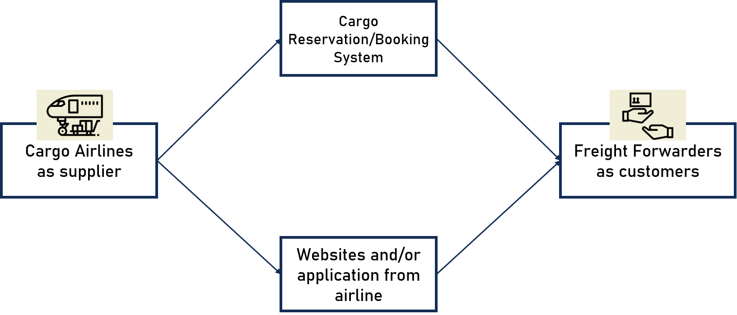
Cargo Airline Distribution Channel
Notes:
Next, this chart shows the distribution channel of a cargo airline in general, or at least how aglis plans to distribute its services. We as a supplier have only 2 channels for freight forwarders to order our service: which is through cargo reservation or booking system, and through the website or application that we make. Cargo reservation system acts as global distribution system of cargo airlines, where freight forwarders can order our services firstly by checking our flight schedules in accordance to the routes they need, and prices we offer.

Slide 26


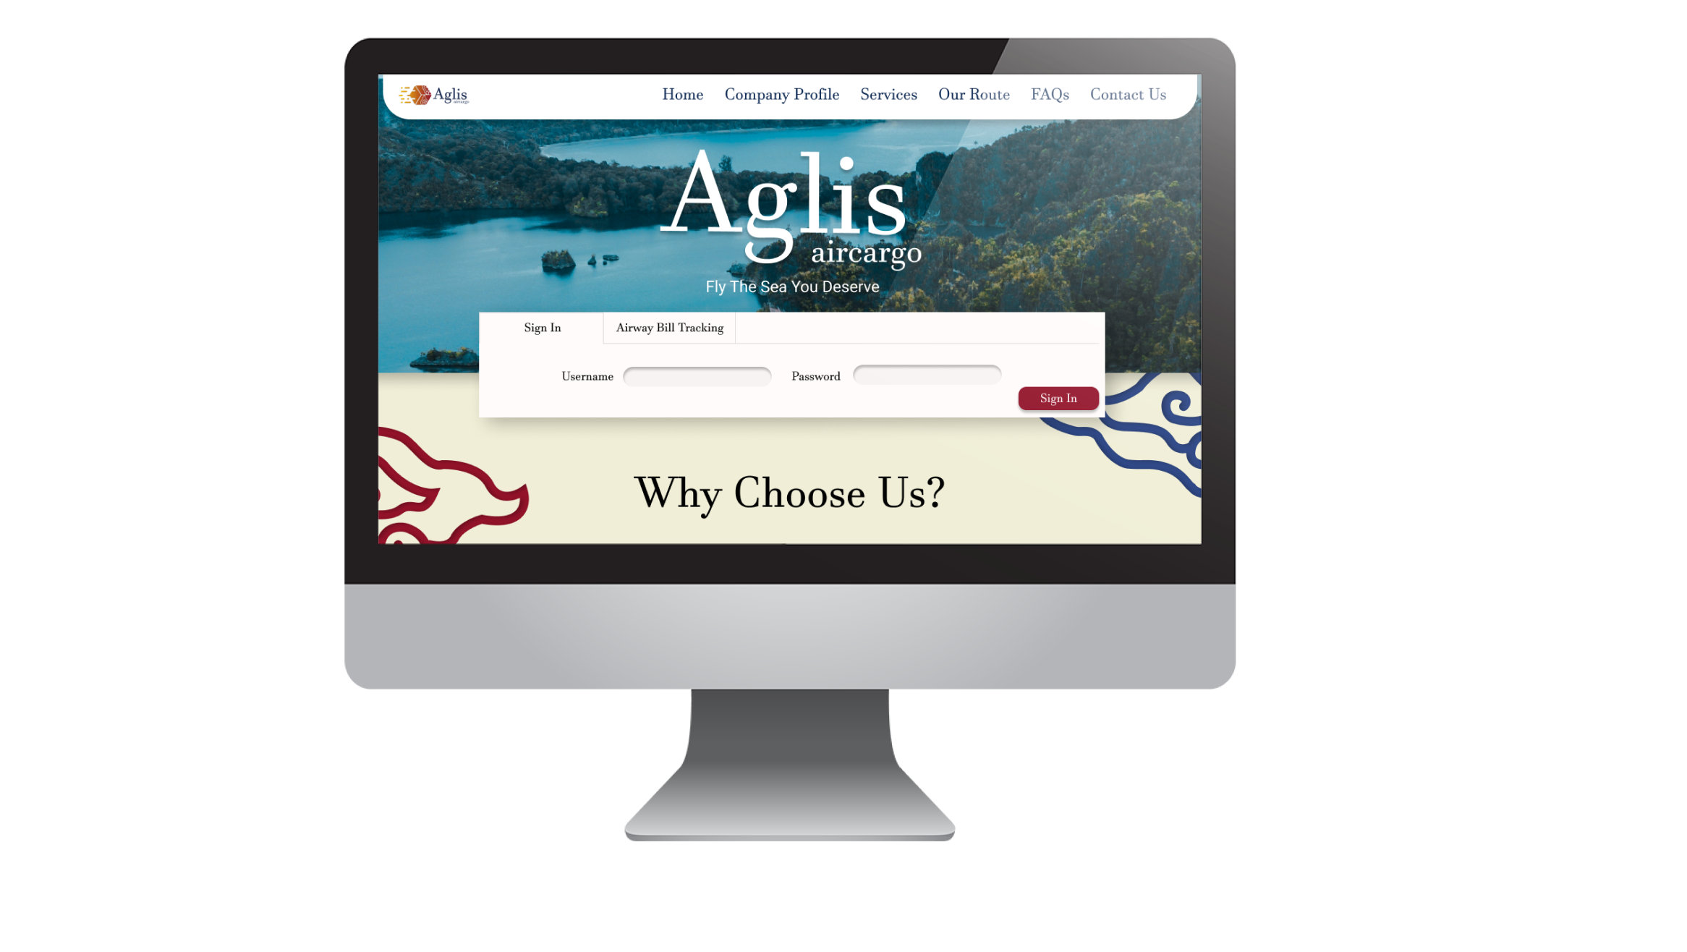
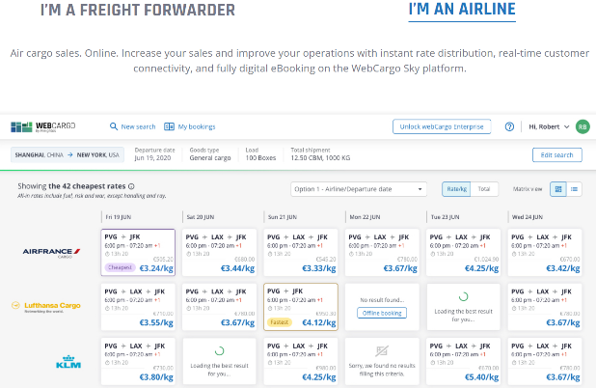
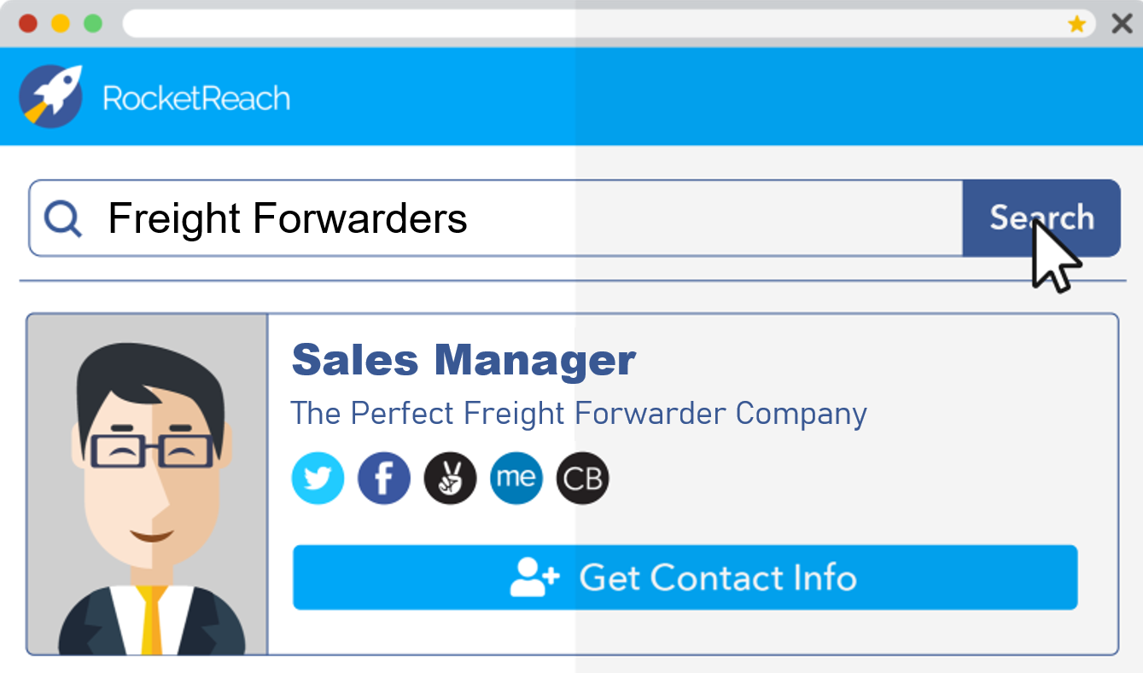
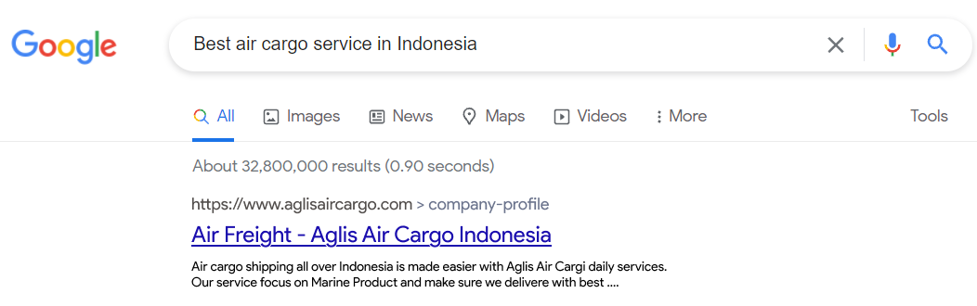
Digital Marketing Strategy
Website & Application
Provides information, contact channel
Internet
Search engine, online cargo booking reservation, newsletters
Notes:
One major field that Aglis will conduct marketing through the internet. First, Aglis will make its own website and application as a medium to connect the company with both our potential and confirmed customers. These two platforms contains information describing Aglis’ profile, and covering operation aspects such as pricing, routes, and scheduling. For those who want to confirm in ordering our services require an official account, where they are able to make orders and track it. Freight forwarders may also contact us regarding their existing orders, or ask questions regarding our services as potential customers.
We will use three main channels on the internet to help expand the company’s popularity. As mentioned earlier, we will register the cargo airlines to various online cargo booking reservations as an additional way for freight forwarders to know our existence. Search engine marketing is an advertising technique where Aglis’s name will be put on top of the search list as another way to gain popularity by tagging particular keywords. We also have a more direct approach by sending email newsletters that introduces us and offer interesting promotions to possible customers, where we will use platforms such as RocketReach to find the appropriate freight forwarders.

Slide 27




Offline Marketing Strategy
Contests
Hold contests related to fish
(fishing and ikan hias )
Sponsorships
Take part as sponsorships in big and crowded events
Notes:
Other than digital, we plan to take part in crowded events as another way to increase name popularity. First, we will hold contests that involves fish which is a fishing competition and ikan hias competition. We hope that serious fishermen may know our company's existence, hoping that in the end they will recommend freight forwarders to use Aglis. Second, Aglis plans to be sponsors of reputable and big events such as marathons or sports competitions.

Slide 28



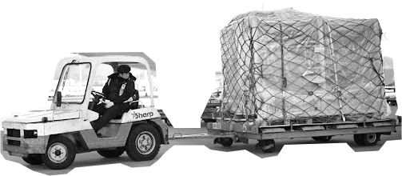
Marketing Strategy to Customers
Teman Aglis
Loyalty programs to attract consistent orders by offering benefits
Point System
Through memberships, points are acquired based on the service ordered
Notes:
As part of our promotion, we have two ways for offering special promos. First is the loyalty program called Teman Aglis, for customers who has ordered our services frequently and that they will be offered interesting benefits based on their tier. The loyalty program is divided to three levels, with gold the highest, silver the middle, and bronze the lower tier. There are a variety of price discounts and slot reservations that can be received by the loyal customers. This is also a way for us to put in interest to them so they will keep using our services especially constantly in a period of time so their tier would not expire.
There is also point system offered for customers registered with membership. They will collect points on the dollars they spend, and once a certain amount of points has been collected, members can trade the points into discounts, also based on tier.

Slide 29
Pricing Strategy
Rotation | Route | GARUDA INDONESIA | LION AIR | Aglis
1 | PLM-SUB | Rp26,500.00 | Rp16,000.00 | Rp18,995.66
 | SUB-CGK | Rp14,000.00 | Rp19,000.00 | Rp21,475.13
 | CGK-PKY | Rp36,000.00 | Rp46,000.00 | Rp14,316.75
 | PKY-CGK | Rp17,000.00 | Rp29,000.00 | Rp22,906.80
 | CGK-PLM | Rp20,000.00 | Rp14,000.00 | Rp20,043.45
2 | MDC-SRG | Rp51,000.00 | Rp39,000.00 | Rp20,809.68
 | SRG-KDI | Rp50,000.00 | Rp47,000.00 | Rp30,256.94
 | KDI-PNK | Rp48,000.00 | Rp54,500.00 | Rp15,158.04
 | PNK-MDC | Rp62,500.00 | Rp53,500.00 | Rp23,889.13
3 | TTE-KNO | Rp60,500.00 | Rp96,500.00 | Rp46,386.27
 | KNO-PKU | Rp17,500.00 | Rp45,000.00 | Rp19,613.95
 | PKU-BDO | Rp18,500.00 | Rp26,500.00 | Rp33,214.86
 | BDO-TTE | Rp71,000.00 | Rp65,000.00 | Rp33,930.70
4 | LOP-TIM | Rp122,000.00 | Rp130,000.00 | Rp57,267.00
 | TIM-AMQ | Rp95,500.00 | Rp90,000.00 | Rp57,267.00
 | AMQ-CGK | Rp31,000.00 | Rp28,500.00 | Rp35,835.08
 | CGK-LOP | Rp39,000.00 | Rp29,500.00 | Rp37,236.74
Pricing for each route is determined by cost and revenue calculations
Aglis is the cheapest option for 10 out of the 17 total routes served

Slide 30
Operation Plan
Notes:
So for cost calculating:

Slide 31
Aircraft Consideration
No. | Airport | Runway Length​
1 | PLM​ | 3000 m​
2 | SUB​ | 3000 m​
3 | PKY​ | 3000 m​
4 | CGK​ | 3000 m​
5 | MDC​ | 2650 m​
6 | SRG​ | 2680 m​
7 | KDI | 2500 m​
8 | TTE​ | 2400 m​
9 | KNO​ | 3750 m​
10 | BDO​ | 2250 m​
11 | LOP​ | 2750 m​
12 | TIM​ | 2340 m​
15 | PNK​ | 2400 m​
16 | AMQ | 2500m
Our route rotations
1​ | PLM-SUB​ | SUB-CGK​ | CGK-PKY​ | PKY-CGK | CGK-PLM
2​ | MDC-SRG​ | SRG-KDI​ | KDI-PNK​ | PNK-MDC​
3​ | TTE-KNO​ | KNO-PKU​ | PKU-BDO​ | BDO-TTE​
4​ | LOP-TIM​ | TIM-AMQ​ | AMQ-CGK​ | CGK-LOP​
Summary:
Shortest runway length : 2250 m (BDO)
Farthest distance : 3182 km (TTE-KNO)
Longest Rotation flight hour: 11.24 hours (rotation 4)

Slide 32
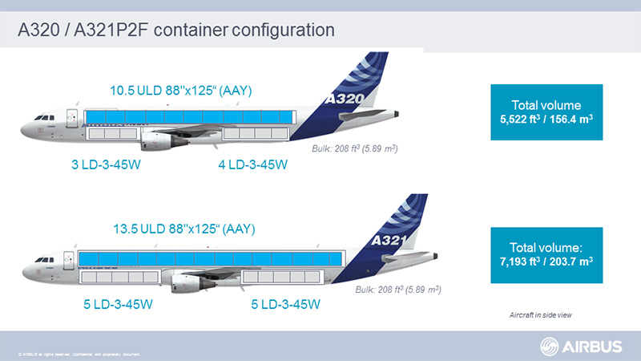
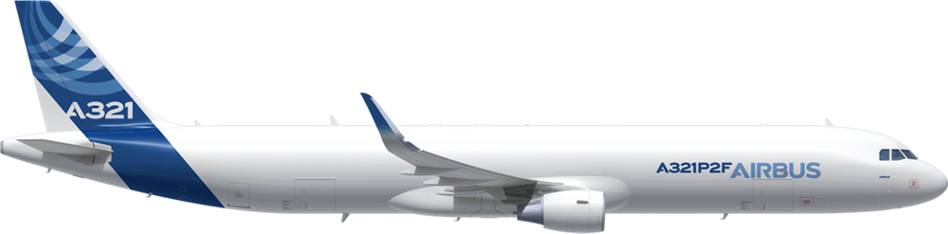
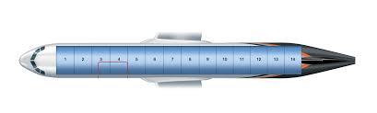
Airbus A321P2F
Specification Value
Maximum Range (km) | 3,800
Take Off Distance (m) | 2,180
Maximum Payload (kg) | 28,000
Fuel Consumption (l/hour) | 2,028.5
Lease Price (US$/month) | 240,000

Slide 33
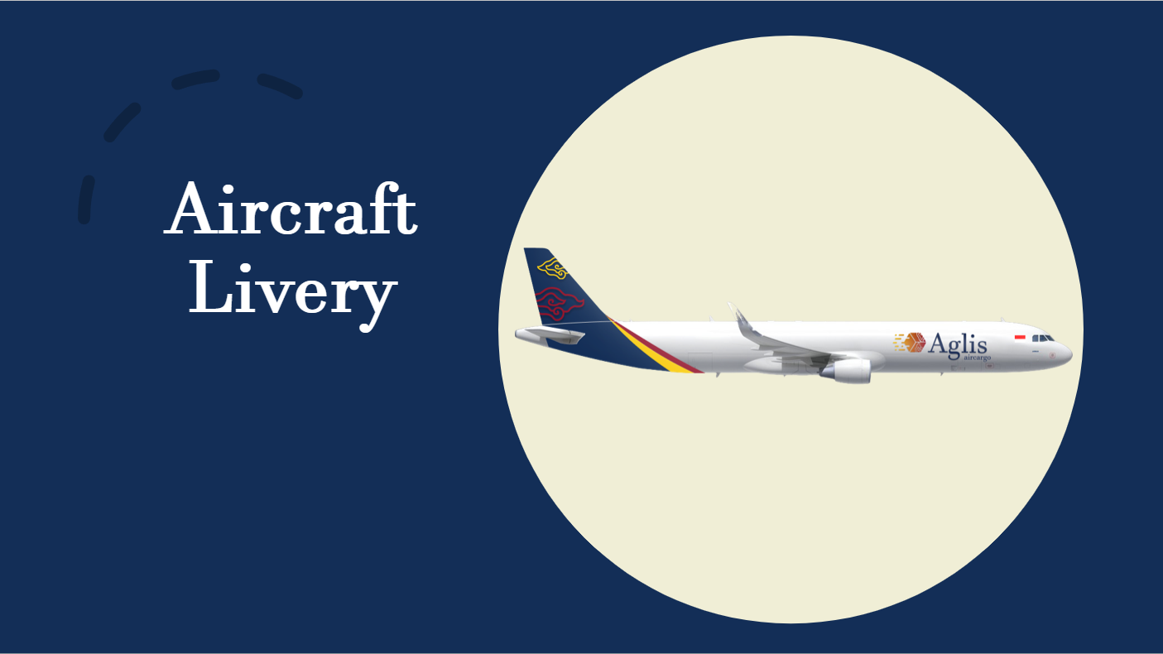


Aircraft Livery

Slide 34

Crew Rotation
1. Define Constraints:
Maximum Flight hour and Duty hour
Minimum Rest hour
Maximum flight hour for 2 pilot crew (7 days consecutive, calendar month, yearly)
2. Find Minimum Crew Needed:
(Sum of flight hour/constraint)
Rotation | 7 Days (hours) | Monthly (hours) | Yearly (hours) | Minimum Crew
1 | 55.39 | 243.14 | 2,815 | 3
2 | 97.64 | 418.47 | 3,963 | 4
3 | 87.97 | 377.03 | 3,737 | 4
4 | 99.36 | 425.85 | 4,115 | 4

Slide 35
Crew Rotation
3. Arrange Crew Sets for each rotation:
Arrange each crew set for each rotation in order to have a regular schedule and is divided equally in order to utilize each crew set effectively. This is done in unison with flight scheduling
4. Check Feasibility:
Check if the schedule generated is feasible using the regulated time constraints, and new constraints such as airport operating hours

Slide 36
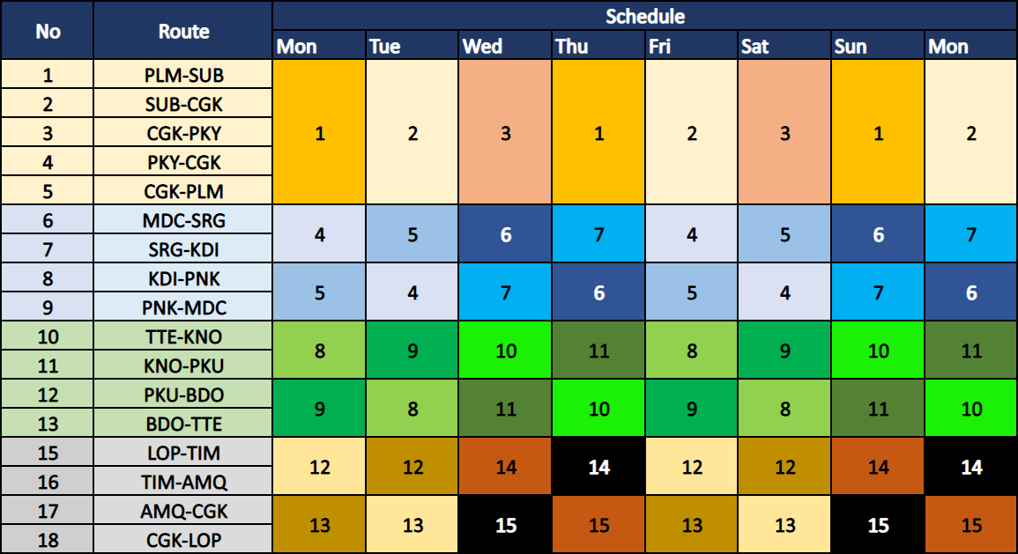
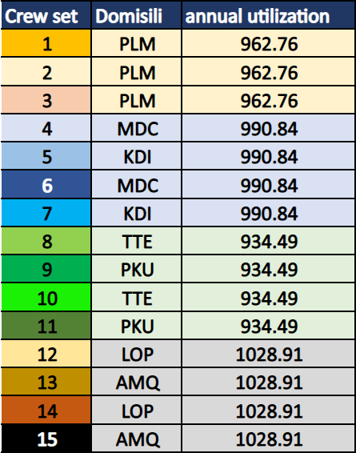
Crew Rotation
15+4 Sets of Crew
Reserve Crew :
4 crew sets stationed in reserve in case of unusual occurrences, one crew set for each rotation and is placed at the start of the rotation

Slide 37
Financial Plan
Notes:
So for cost calculating:

Slide 38
Aglis Cost Structure

Slide 39
Aglis Cost Structure
Average Direct Cost Structure
Average Indirect Cost Structure

Slide 40
Revenue & Cost for 10 years
Assumption:
For year 2023-2027, revenue is based on Aglis market share demand that could be carried
For year 2028-2030, it is assumed 2% increase of revenue per year
For year 2031-2032, it is assumed that revenue will not increase due to a saturated market.

Slide 41
NPV & Net Profit Margin
NPV | Current Values | Present Values
5 year | -$88,491,483 | -$83,741,264
10 year | $2,395,789 | $1,116,472

Slide 42
5 Years Plan
Notes:
Now we will discuss the 5 year plan

Slide 43
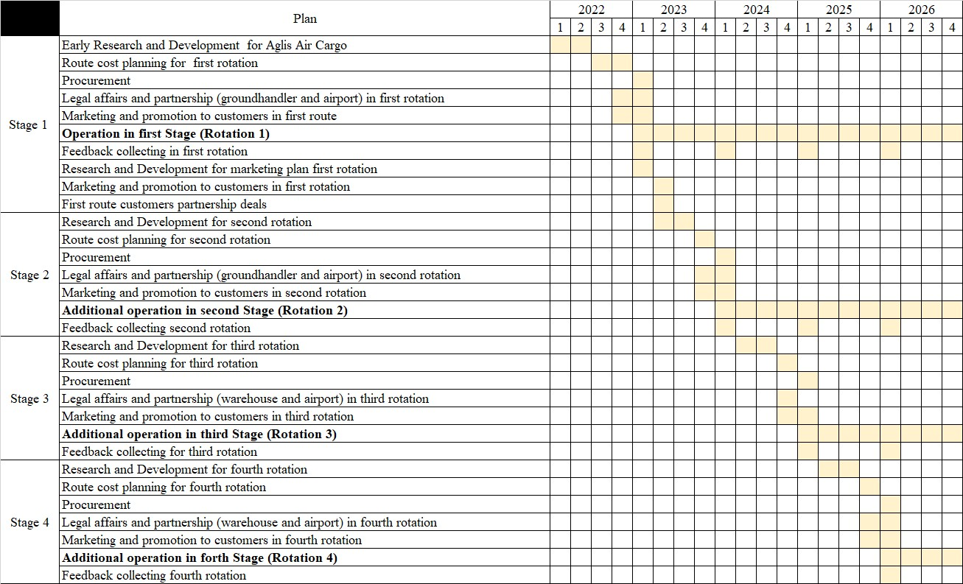
Notes:
Here's tabulated Aglis plan into the next 5 years through Gantt Chart. Aglis divided this 5 years into 4 stage of developing. Each stage represent the 4 rotation that will be served. All stage start with Research and Development, Cost Planning, Procurement, Legal Affairs and Partnership, Marketing and Promotion, operation, and feedback collecting . However in the first year we will have soft opening first to understand and capture the market's interest

Slide 44
Fleet Plan
Stage 3:
Rotation 1: 1 Aircraft
Rotation 2: 1 Aircraft Rotation 3: 1 Aircraft
Stage 1:
Rotation 1: 1 Aircraft
Stage 4:
Rotation 1: 1 Aircraft
Rotation 2: 1 Aircraft Rotation 3: 1 Aircraft Rotation 4: 1 Aircraft
Stage 2:
Rotation 1: 1 Aircraft
Rotation 2: 1 Aircraft
All Using A321P2F Aircrafts
Notes:
This figures illustrate the 5 years for fleet plan. Using A321P2F aircraft, to cover the existing demand all stage through out the 5 year needs only one aircraft. We also choose only one aircraft to make the Maintenace easier

Slide 45
Anugurihiitusomi Terima Kasih
Notes:
Thank you for listening and watching our presentation. Any feedback, comment, question, and suggestion are welcome

